Slide 1
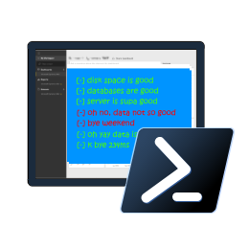

Reliable, Repeatable, Configurable & Automated Validation with
PowerShell dbachecks
Rob Sewell @sqldbawithbeard https://sqldbawithAbeard.com

Slide 2
Speaker Questionnaire
Name : Rob
Occupation : DBA, Automator, Do-er, Trainer
Interests : PowerShell, Automation And SQL (PaaS geddit?)
Interesting Fact : Beard. (Still) Plays Cricket, Flies Drone
Speaker : SQL Saturdays, SQL Relay, PowerShell Events
Community : SQL South West , SQL Sat Exeter , PowerShell VG, PowerShell Conference EU Organiser, dbareports, dbatools, dbachecks, MVP

Slide 3
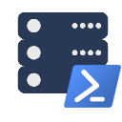






Contact Me
Quick Poll
@sqldbawithbeard
robsewellsqldba
sqldbawithAbeard.com
mrrobsewell@outlook.com
RobSewell.info

Slide 4

Check Lists
Photo by Glenn Carstens-Peters on Unsplash

Slide 5
What is Pester?
Test Runner for PowerShell
A Unit Testing Framework
An Infrastructure Testing Framework
https://github.com/pester
Notes:
https://www.youtube.com/watch?v=lNCR5yLSwi0 -- Test your Powershell with Pester and PSScriptAnalyzer
“Untested Code is Broken Code”
Infrastructure Testing with Pester - https://www.youtube.com/watch?v=zSEK74_fsLw
Pester is a unit-testing framework for PowerShell, and perhaps the first open-source software product that ships with Windows itself!
Author Adam Bertram will walk you through the Pester philosophy, syntax, and numerous real-world examples in this "Agile-published" book.
The Pester Book
https://leanpub.com/creatinghtmlreportsinwindowspowershell
https://leanpub.com/powershell-scripting-toolmaking
https://leanpub.com/pesterbook

Slide 6
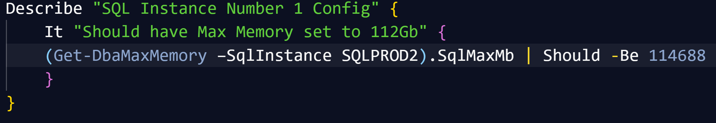
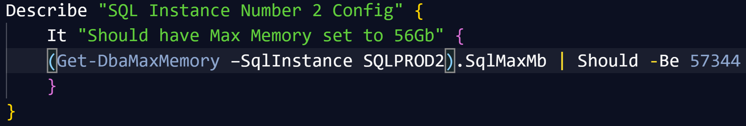
Pester
Writing Pester Tests for one SQL instance is easy
Writing slightly different Pester Tests for slightly different instances is copy and paste
It is possible to parameterize Pester tests (but not so easy to say!)

Slide 7

Challenges & Goals

Slide 8
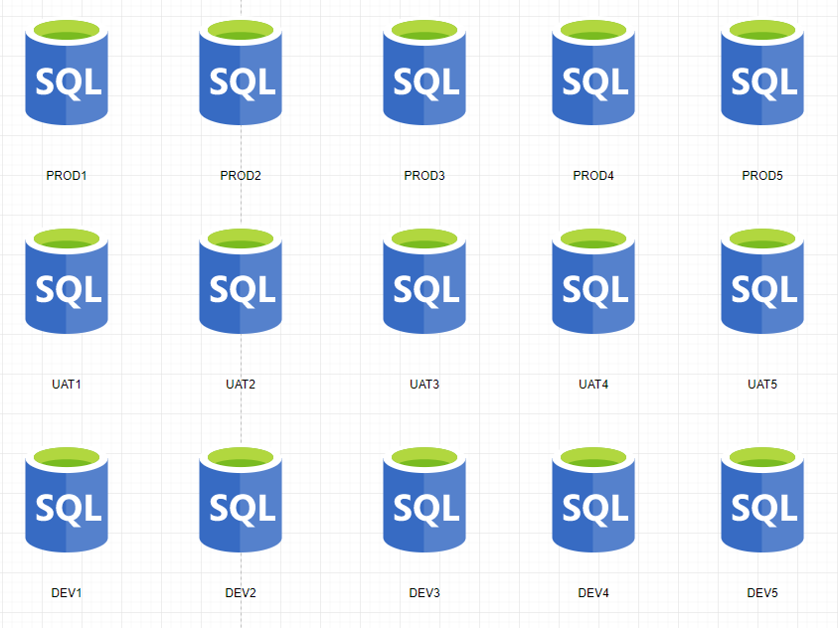
Consider Your SQL Environment

Slide 9
Consider Your SQL Environment
PRODUCTION
No SA account
Backup Compression
FULL Recovery
Secure Backup Location
Agent Alerts
Production Agent Jobs
Only Certain Production AD Groups allowed
And much more

Slide 10
Consider Your SQL Environment
TEST
Different Backup Strategy
Test Agent Jobs
Needs the Testers AD Groups
And much more

Slide 11
Consider Your SQL Environment
Development
Simple Recovery
No Agent Jobs
Definitely no Production AD Information
SA Account
And much more

Slide 12
Consider Your SQL Environment
Widget One
Global view of one ‘widgets’ environments might be needed for
Project Managers
Team Leaders
Release Managers
Agile Teams

Slide 13
Consider Your SQL Environment
Special Snowflakes
For those ‘special’ SQL Servers that don’t fit in the usual boxes
I.E. SharePoint

Slide 14
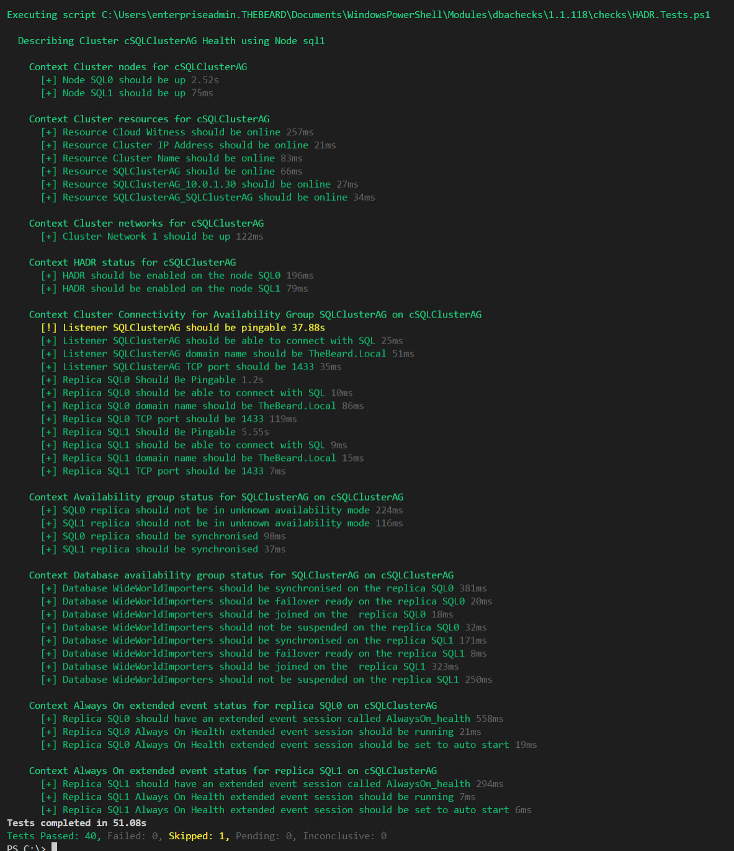
Challenge - Output
DBAs may need
output instantly

Slide 15
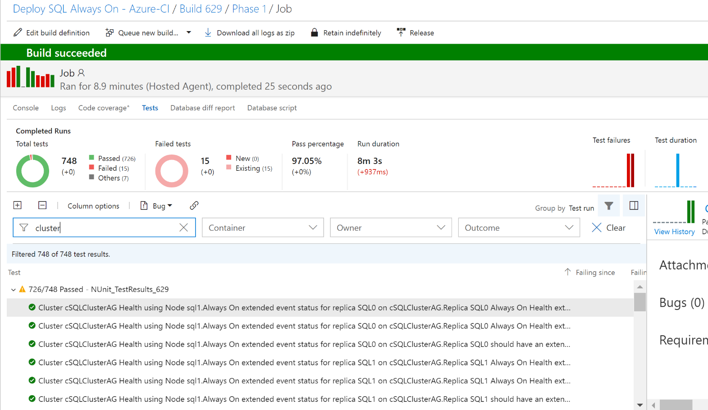
Challenge - Output
DBAs may want to automate and integrate with other solutions (DevOps, Daily Checks, Incident Response, Maintenance Windows)

Slide 16
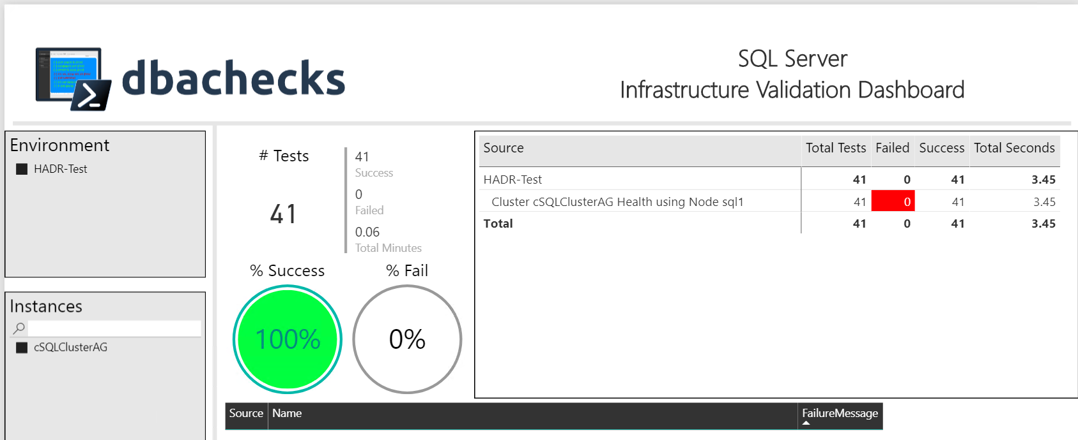
Challenge - Output
Management want output they understand
– (and with pretty interactive pictures !)

Slide 17
Our Goal
Create redistributable, easily configurable Pester tests using industry leaders checklists
Enable output to suit the requirements of different types of end users human and machine
Capability to provide response/resolution ?

Slide 18
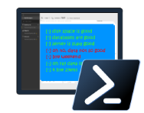
dbachecks
dbachecks is a framework created by and for SQL Server pros who need to validate their environments.
This open source module allows
us to crowdsource our checklists using Pester tests.
Notes:
Basically, we all share similar checklists and mostly just the server names and RPO/RTO/etc change.

Slide 19




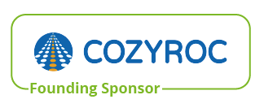







System Requirements
Gold Sponsors
Minimum
Recommended
Client
PowerShell v4
Modules
dbatools
Pester
PSFramework
Client
PowerShell v5.1
Server
Everything dbatools supports
From SQL2000 to SQL vNext
Silver Sponsors
Bronze Sponsors
Local Partners

Slide 20
Gold Sponsors
Gold Sponsors
Gold Sponsors
Silver Sponsors
Silver Sponsors
Silver Sponsors
Bronze Sponsors
Local Partners
Bronze Sponsors
Local Partners
Bronze Sponsors

Slide 21
Install is easy
PowerShell Gallery
Install-Module dbachecks
Install-Module dbachecks –Scope CurrentUser
* Automatically installs required modules

Slide 22
Need an offline install?
Save-Module dbachecks, dbatools, Pester, PSFramework

Slide 23
What Checks Are Available?
PowerShell > Get-DbcCheck

Slide 24
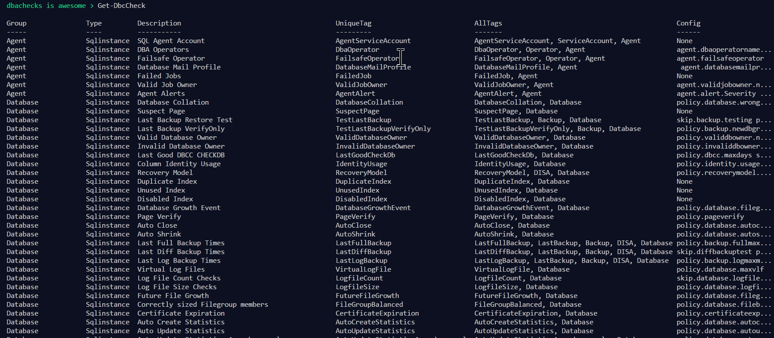
What Checks Are Available? Use Get-DbcCheck

Slide 25
What Configs Are Available?
PowerShell > Get-DbcConfig

Slide 26
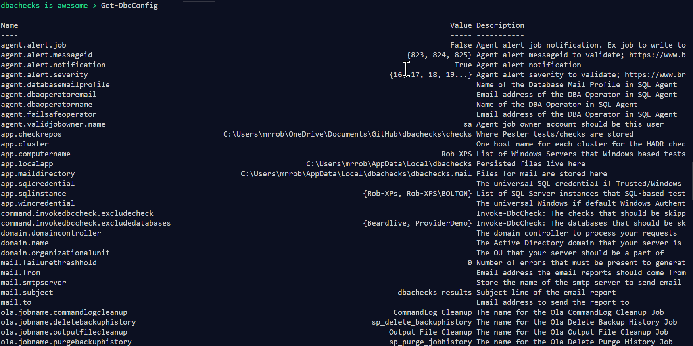
What Configs Are Available? Use Get-DbcConfig

Slide 27
How Do I Run A Check?
PowerShell > Invoke-DbcCheck –SqlInstance ROB-XPS –Check FailedJob

Slide 28
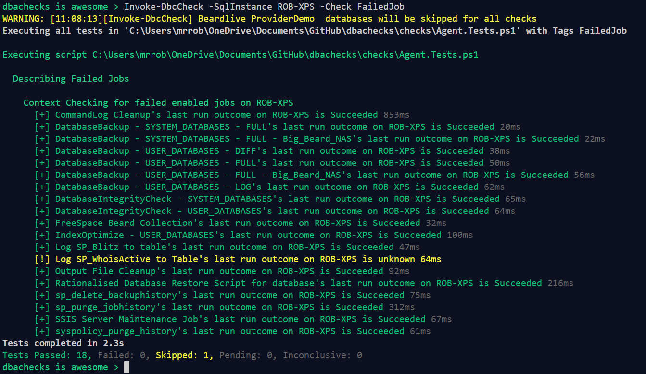
Invoke-DbcCheck – Run A Check

Slide 29
Configurations?
> # Set the instances to check
> Set-DbcConfig -Name app.sqlinstance Rob-XPS
> Invoke-DbcCheck -Check OlaInstalled

Slide 30
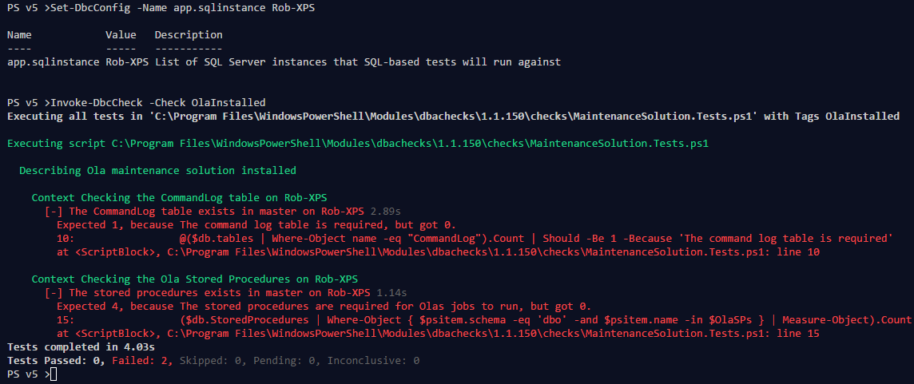
Configurations?

Slide 31
Configurations?
I don’t have Ola installed in the default database (master)
> Set-DbcConfig -Name policy.ola.database -Value DBA-Admin
> Invoke-DbcCheck -Check OlaInstalled

Slide 32
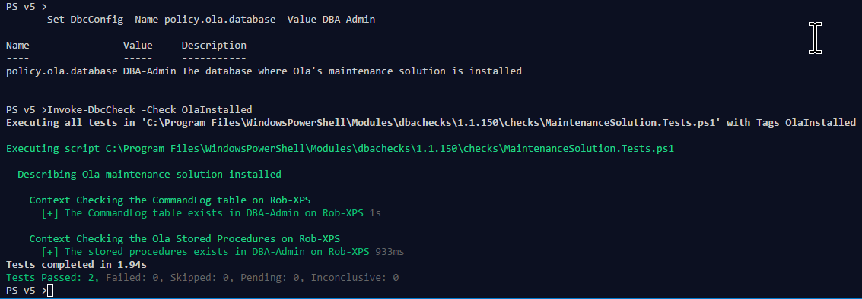
Configurations?

Slide 33
Export-DbcConfig/Import-DbcConfig
Export-DbcConfig –Path C:\Users\Beard\git\PesterConfigs\Application1_PROD.json
Export-DbcConfig -Path C:\Users\Hair\git\PesterConfigs\Client1_System2_Quick.json
Import-DbcConfig -Path Git:\PesterConfigs\Application1_PROD.json
Invoke-DbcCheck
Import-DbcConfig -Path Git:\PesterConfigs\Client1_System2_Quick.json
Invoke-DbcCheck

Slide 34
Start-DbcPowerBi
Import-DbcConfig –path Git:\PesterConfigs\App1_Dev.json
Invoke-DbcCheck -Show Summary -PassThru | Update-DbcPowerBiDataSource –Environment Development
Import-DbcConfig –path Git:\PesterConfigs\App1_Test.json
Invoke-DbcCheck -Show Summary -PassThru | Update-DbcPowerBiDataSource –Environment Test
Import-DbcConfig –path Git:\PesterConfigs\App1_PROD.json
Invoke-DbcCheck -Show Summary -PassThru | Update-DbcPowerBiDataSource –Environment Production
Start-DbcPowerbi

Slide 35
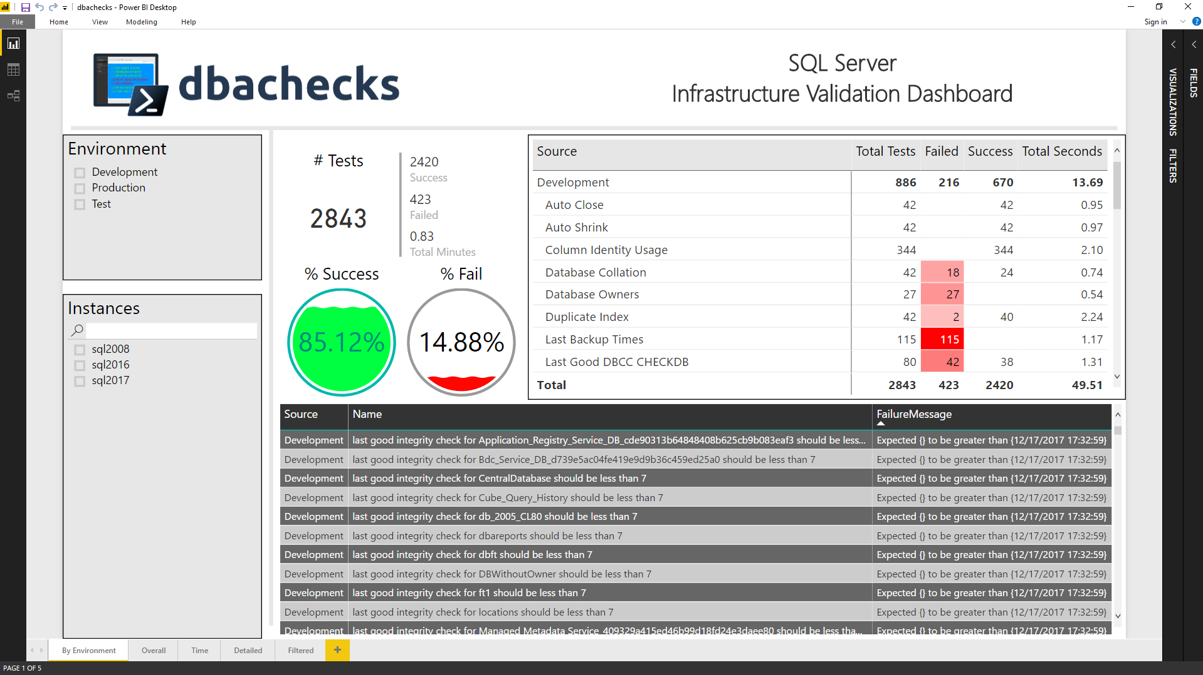
Start-DbcPowerBi

Slide 36

It’s Nearly Time for a Demo
But First A Thank You

Slide 37

Hey Beardy !
MUST BE TIME FOR A DEMO

Slide 38
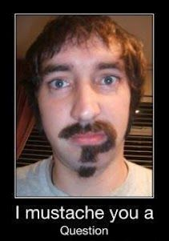
Questions?
?
?
?
?
?
?
?
?
?
?
?
?
?
?
?
?
Rob Sewell @sqldbawithbeard https://sqldbawithAbeard.com

Slide 39
Contact Me
Quick Poll
@sqldbawithbeard
robsewellsqldba
sqldbawithAbeard.com
mrrobsewell@outlook.com
RobSewell.info

